Slide 1
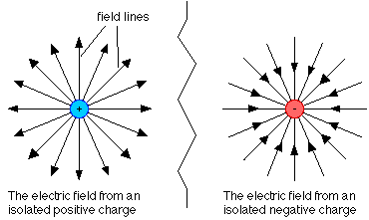
Recall:
size of test charge doesn’t effect “E”
Field lines:

Slide 2
Recall: Charged particles in electric field
Electric field lines are often called lines of force, and if we re-arrange the electric field equation we can see why.
+Q
-Q
The force felt by the charge q is in the same direction of the electric field if q is positive and is opposite the electric field if q is negative.

Slide 3
To represent the strength of the electric field, the number of lines that enter or leave a charge are proportional to the magnitude of the charge.
If Q₁ is 1 μC and Q₂ is -2μC then half as many field lines leave _______ as enter ________.
Q₁
Q₂

Slide 4
Draw the field lines for the following situations:

