Slide 1
Electric Field Strength

Slide 2
Electric Field
Physicists did not like the concept of “action at a distance” i.e. a force that was “caused” by an object a long distance away
They preferred to think of an object producing a “field” and other objects interacting with that field
Thus rather than ...
-
they liked to think...
-
+
+

Slide 3
Field strength:
Field strength is the force available to influence a test charge.
At a particular point, the field strength is the result of all the charges in the region that are creating the field.
The field in following figure is created by only one charge..

Slide 4
Electric Field
Electric Field E is defined as the force acting on a test particle divided by the charge of that test particle
Thus Electric Field from a single charge is
+Q₀
Q

Slide 5
EFS (by definition)
The electric field strength, E , is the force, Felec, per unit charge, q, at a point. The equation for EFS is (arrows show the units for each symbol)
E = Felec
q
N/C
N
C

Slide 6
Electric Field of a single charge
+Q₀
+Q₀
+Q₀
+Q₀
Electric Field from isolated charges (interactive)
+
Electric field from test particles
Note: the Electric Field is defined everywhere, even if there is no test charge is not there.

Slide 7
Charged particles in electric field
Using the Field to determine the force
+Q
-Q

Slide 8
Representation of the Electric Field
To represent the electric field with lines whose direction indicates the direction of the field
Notice that as we move away from the charge, the density of lines decreases
These are called
Electric Field Lines

Slide 9
Drawing Electric Field Lines
The lines must begin on positive charges (or infinity)
The lines must end on negative charges (or infinity)
The number of lines leaving a +ve charge (or approaching a -ve charge) is proportional to the magnitude of the charge
electric field lines cannot cross

Slide 10
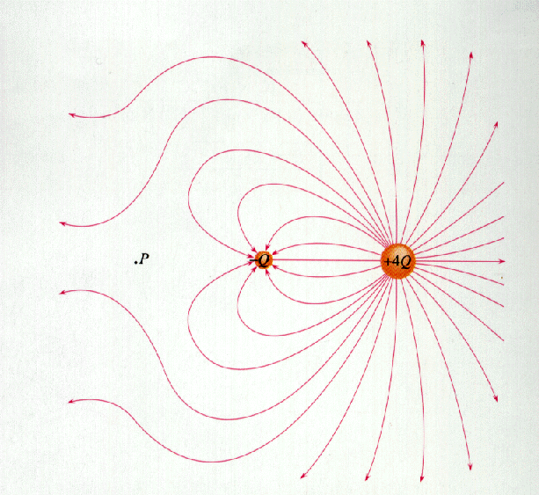
Drawing Electric Field Lines: Examples
From Electric field vectors to field lines
Field lines from all angles
Field lines representation

Slide 11
Electric Field Strength
Steps to measure EFS, E, at some point.
Place small + test charge (q) at that point
Measure the force (Felec) exerted on the test charge
Divide force by the size (amt.) of test charge

Slide 12
Example Problems
If the electric field strength due to some charged object is 1.5E3 N/C, find the force on a positive charge due to 2E-4 C placed in the field.
Known: E = 1.5E3 N/C & q = 2E-4 C
Unknown = Felec
Equation: E = Felec / q (solve for Felec)

Slide 13
Example Problems (cont.)
Felec = (1.5E3 N/C) x (2E-4 C)
= 0.30 N
If the charge on the object in example #1 was doubled, does that change the electric field strength? Hint: what change would increasing q have on Felec?

Slide 14
Example Problem (cont.)
Increasing q will increase Felec so ratio between the two is constant.
Conclusion = size of test charge doesn’t effect “E”

Slide 15
EFS Lines of Flux
Directions & Strength of Electric Field (on board)
Facts:
More flux lines indicates a stronger electric field
Lines of flux should always be drawn so they are perp. to surface of the charge
Lines of flux should never cross

Slide 16
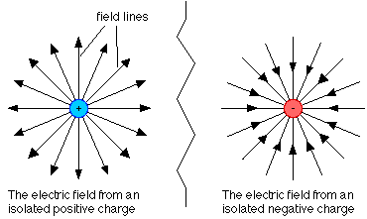
Recall:
size of test charge doesn’t effect “E”
Field lines:

Slide 17
Recall: Charged particles in electric field
Electric field lines are often called lines of force, and if we re-arrange the electric field equation we can see why.
+Q
-Q
The force felt by the charge q is in the same direction of the electric field if q is positive and is opposite the electric field if q is negative.

Slide 18
To represent the strength of the electric field, the number of lines that enter or leave a charge are proportional to the magnitude of the charge.
If Q₁ is 1 μC and Q₂ is -2μC then half as many field lines leave _______ as enter ________.
Q₁
Q₂

Slide 19
Draw the field lines for the following situations:

