Slide 1
Review of Science 10
In Science 10 we learned that certain objects called magnets can exert a force on iron and other ferromagnetic materials such as cobalt, nickel, and gadolinium.
Magnets are made of ___________ materials, usually iron, and have special properties at the atomic level, which allow them to be magnetized.
feromagnetic

Slide 2
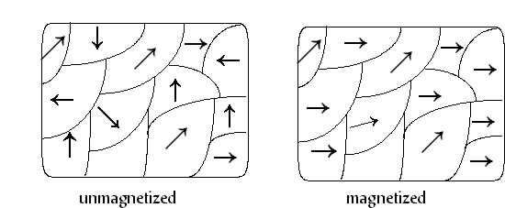
Small groups of atoms in a ferromagnetic material are called domains and each domain has its own magnetic field.
As shown in the pictures to the right.
The domains of a material can be aligned, made to point the same direction, by an external magnetic field and in doing so produce what is called a permanent magnet.
A magnetized ferromagnetic material can be demagnetized by making the magnetic domains point in different directions.
This can be accomplished by heating the magnet past its Curie temperature , hammering etc.
A magnet will lose its magnetism if heated above the Curie temperature.

Slide 3
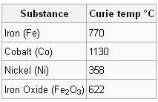
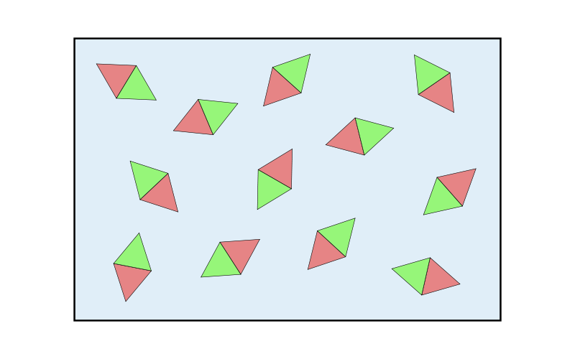
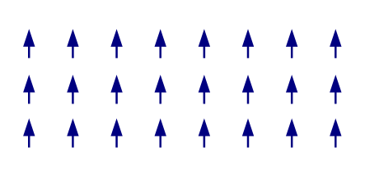
Given below are various Curie temperatures for different substances.
Above the Curie temperature, the magnetic spins are randomly aligned unless a magnetic field is applied.
Below the Curie temperature, neighboring magnetic spins align in a ferromagnet.

Slide 4
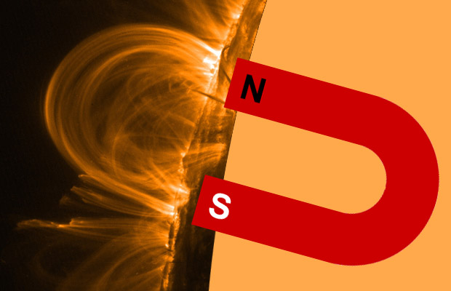
ALL magnets have two poles
NORTH seeking pole
SOUTH seeking pole

Slide 5
Breaking a magnet produces two magnets!
N
S
N
S
N
S
N
S

Slide 6
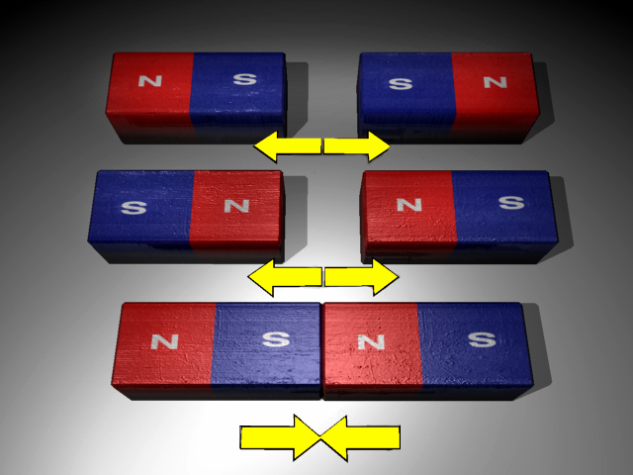
Opposite poles attract and like poles repel

Slide 7
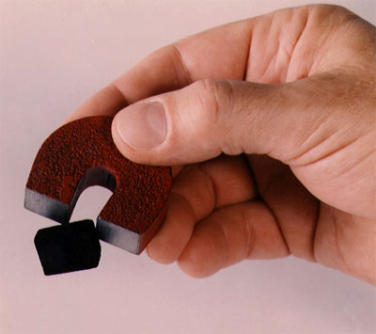
Magnetic materials

Slide 8
Magnetic materials
Iron (steel), Cobalt and Nickel

Slide 9
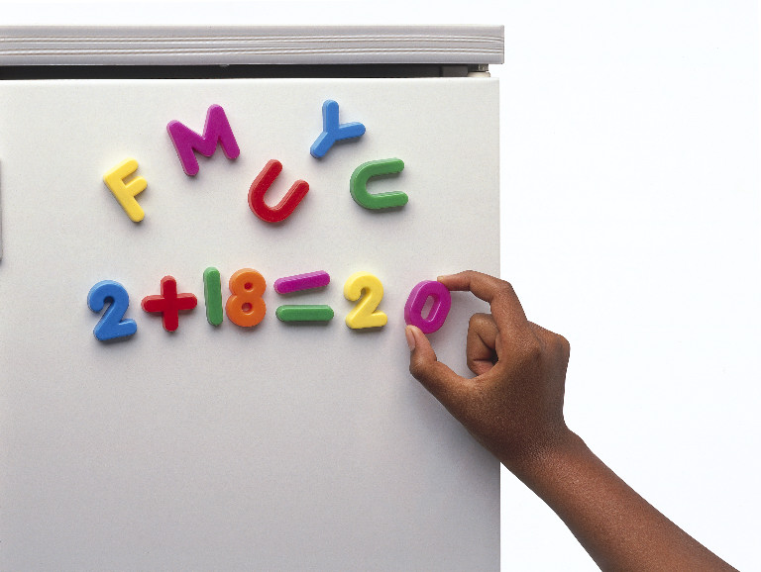
Magnetic induction

Slide 10
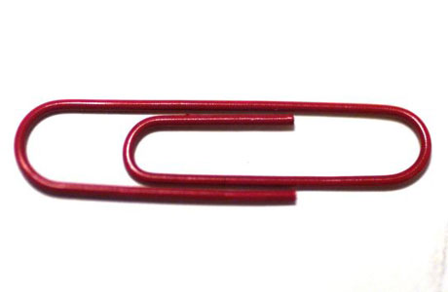
Magnetic induction
When a magnetic material is close to a magnet, it becomes a magnet itself
We say it has induced magnetism
magnet
S
N
S
N

Slide 11
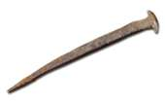
Soft Magnetism
Hard and Soft Magnetism
Pure iron is a soft magnetic material
It is easy to magnetise but loses its magnetism easily
before
after
N
S
S
N
S
N
N
Not a magnet
Iron nail

Slide 12
Hard Magnetism
Steel is a hard magnetic material
It is harder to magnetise, but keeps its magnetism (it is used to make magnets!)
before
after
S
N
S
N
S
N
N
S
N
It’s a magnet!
Steel paper clip

Slide 13
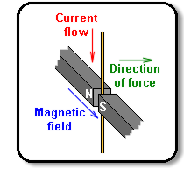
Magnetic field
Magnets and electric currents produce magnetic fields around them.
In a magnetic field, another magnet, a magnetic material or a moving charge will experience a magnetic force.

Slide 14
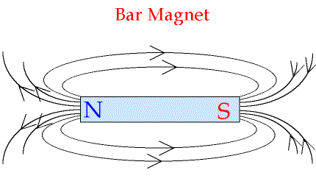
Magnetic field lines
We can represent the magnetic field around a wire or magnet using field lines.

Slide 15
Magnetic field lines
The arrows show the direction a compass needle would point at that point in the field.

Slide 16
Magnetic field lines
The arrows show the direction a compass needle would point at that point in the field.
Note that magnetic field is a vector quantity
The closer the field lines are, the stronger the magnetic force felt

Slide 17
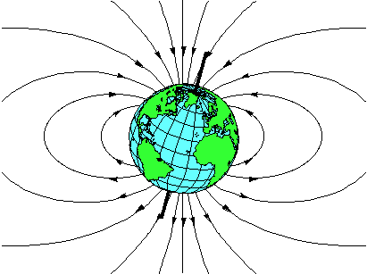
Earth’s Magnetic Field
Remember the North of a compass needle points to the geographic north pole (i.e. the geographic North pole is a magnetic south pole!)
S
N

