Slide 1
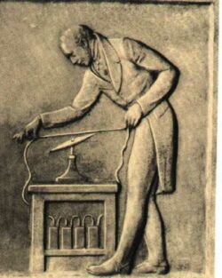
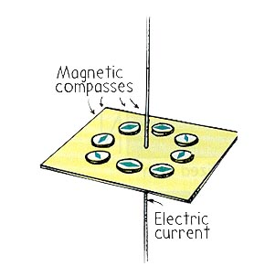
Electromagnetism
It was observed in the 18th century that an electric current can deflect a compass needle the same way a magnetic field can, and a connection between these two phenomenon was sought after.
It was found that a current carrying wire creates a magnetic field around it in a circular shape with the wire at the center.
The direction of the magnetic field can be found with the first right hand rule.

Slide 2
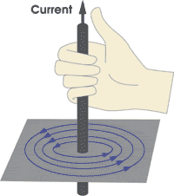
First right hand rule.
To use the first right hand rule you:
a) Point your right thumb in the direction of conventional current.
b) Curl your fingers around the wire, and they point in the direction of the magnetic field.

Slide 3
Sometimes a wire is shown to be going into or out of the page, or a magnetic field is directed in or out of the page.
For a magnetic field going into the page, the symbol used is an x and for the field going into the page it is a dot.

Slide 4
Solenoid
If a current carrying wire is wrapped into a circular shape or loop, it is then called a solenoid.
By placing an iron core in the solenoid you can create an electromagnet.
The magnetic field for solenoid is similar to that of a bar magnet as shown.

Slide 5
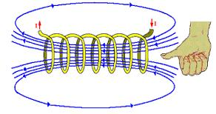
To determine the direction of the magnetic field inside and around a solenoid you can use the first or second right hand rule.
2nd RIGHT-HAND RULE
If you grasp the coil with the right hand and curl your fingers around the loops in the direction of the conventional current, your thumb points towards the North pole of the electromagnet.

Slide 6
The Force on an Electric Current in a Magnetic Field
a current flowing through a wire could exert a force on a compass needle, which is basically a small magnet.
From Newton’s Third law we can think that a magnet should also exert a force on the current carrying wire and this has been shown experimentally.
The force experience on the current carrying wire or magnetic force is not in the direction of the magnetic field!
The force is actually perpendicular to the magnetic field and to the direction of the current flow.

Slide 7
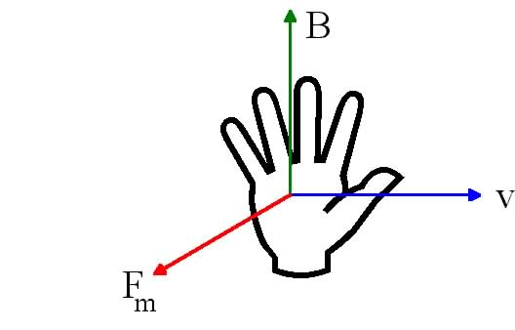
If we image a current carrying wire is placed between the ends of a bar magnet, the direction of the force can be found with the Third Right Hand Rule.
You place you right thumb in the direction of conventional current or positive charge, your “straight” fingers point in the direction of the magnetic field, and your palm points in the direction of the force. (Shown above)

Slide 8
Practice: Determine the direction of the force on the current carrying wire and write it below.
a) The wire carries conventional current into the page, and the magnetic field goes from left to right.
b) The wire carries real current into the page and the magnetic field is pointed down.
c) The wire carries conventional current from left to right and the magnetic field is pointed up.
d) The wire carries real current from left to right and the magnetic field is out of the page.

Slide 9
The Definition of the Magnetic Field and Formula for Magnetic Force
The magnitude of the magnetic force has been experimentally found to be directly proportional to three things: **It is assumed that the magnetic field is uniform**
the length of the wire in the uniform magnetic field, the current in the wire, and the strength of the magnetic field.
Where I is the current, l is the length of the wire, and B is the magnetic field strength.

Slide 10
However, the magnetic field is defined in terms of the proportion shown above and also depends on the angle between the current and the field.
We should notice that if the angle between the current and field is 90 degrees than the force is a maximum and if the angle is 0 then the force is zero.
The magnetic field is defined in terms of the force equation and is given units of tesla T, where

Slide 11
Ex 1: A wire 0.10 m long carries a current of 5.0 A from left to right. The wire is at right angles to a uniform magnetic field. The force on the wire is 0.20 N upwards. What is the magnitude and direction of the magnetic field, B?
Ex 2: A wire 115 m long is at right angles to a uniform magnetic field. The field has a magnetic field strength of 5.0 x 10⁻⁵ T in the positive x direction. The current through the wire is 4.0 x 10² A into the page. Find the magnitude and direction of the force.

Slide 12
Practice: Solve the following problems
1 a) A wire runs from east to west and carries 22 A of current. Assume that the Earth’s magnetic field is directed from south to north, with a magnitude of 5.0 x 10⁻⁵ T. Find the magnitude and direction of the force on a 36 m length of wire. b) Now the current goes from north to south? c) From south to north? [0.040 N into the ground] [0 N] [0 N]
2. Calculate the magnitude of the force per unit length on a 35 m long wire carrying 12 A of current, perpendicular to a 0.034 T magnetic field (0.41 N)

