Slide 1
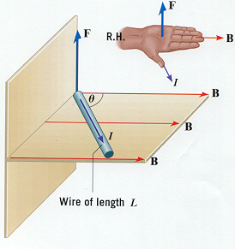
Starter:
Determine the direction of the missing vector.
(I is conventional Current)
F is right, B is up, I is ________
I is in to page, B is up, F is ________
I is down, F is out, B is ________
B is left, F is out, I is _________
B is in, I is up, F is _________
F is left, I is out, B is _________

Slide 2
The Magnetic Field for a Current Carrying Wire
A straight current carrying wire creates a circular magnetic field around the wire and we can determine the direction of the field with the first right hand rule.
This magnetic field is not uniform, meaning it changes as we move away from the wire.

Slide 3
The magnitude of this field is proportional to the current and inversely proportional to the distance to the wire, and can be expressed with the following equation:
Where r = the perpendicular distance to the wire,
is a constant called the permeability of free space and has a value of

Slide 4
Ex 1: Calculate the magnetic field strength due to a long wire that carries a current of 6.0 A at a point 1.0 cm away from the wire? [1.2 x 10⁻⁴ T]
Ex 2: At what perpendicular distance from a wire with 25 A flowing through it must you be to have a magnetic field equal to 2.5 x 10⁻⁴ T?

Slide 5
The Force between Two Current Carrying Wires
A current carrying wire placed in a magnetic field experiences a force and also creates its own magnetic field.
If we place two current carrying wires together they will put a force on each other but what we have to recognize is that a wire cannot put a force on itself.

Slide 6
Ex 3: Two 15 m long wires are placed side by side as shown in the picture and a current of 10 A is run through them. If the wires are 0.05 m apart, calculate the force experienced by each wire
a) The first step is to find the magnetic field created by each wire.
b) The second step is to find the force on each wire,
using the magnetic field from the other wire.

Slide 7
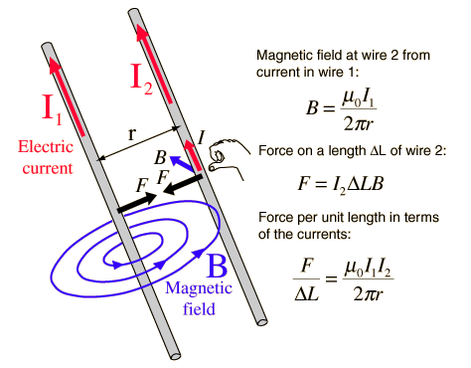

Slide 8
Ex 4: A 10 m long wire has current of 5.0 A running upwards. 1.0 cm to the left is another wire of the same length with the same current but in the opposite direction. What is the magnitude and direction of the force on each wire?
What we should notice from the examples 3 and 4 is that where the current in the wires is in the same direction
the wires ________________ each other, and when the current is opposite the wires ____________ each other.

Slide 9
The Force on a Moving Positive Charge
The force on a current carrying conductor is really just a wire which has moving charges traveling through it.
The force on the wire occurs because of the force experienced on the moving charges.
Recall:
is how far the charges move in a period of time it is the same thing as the velocity of the charge, v.
Where the angle is between the velocity and magnetic field vectors (usually 90º).
To find the direction of the force we use the 3rd Right Hand Rule.

Slide 10
Examples:
Ex 1: An airplane acquires a net charge of 150 C and flies in a direction of 225 m/s East. A uniform magnetic field of 5.0 x 10⁻⁴ T points downward. Find the magnitude and direction of the magnetic force the plane experiences. [17 N North]
Ex 2: A proton moves to the west at 3.58 x 10⁶ m/s in a uniform magnetic field of 1.30 T downward. Find the magnitude and direction of the force on the proton? [7.45 x 10⁻¹³ N South]

Slide 11
Since not all charges are positive, we need to know how to find the direction of the force on a negative moving charge.
To do this we can use two methods:
Either use the opposite direction for the velocity and the 3rd right hand rule, or use the given direction of the velocity and do the 3rd right hand rule with your left hand!

Slide 12
Ex 3: An electron moves to the west at 3.58 x 10⁶ m/s in a uniform magnetic field of 1.30 T upward. Find the magnitude and direction of the force on the electron? [7.45 x 10⁻¹³ N South]
Ex 4: A electron is fired at 2.67 x 10⁵ m/s East in a magnetic field produced by a horseshoe magnet of 0.035 T North. Find the magnitude and direction of the force on the charge. [1.5 x 10⁻¹⁵ N down]

Slide 13
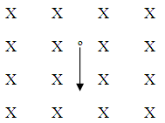
The Path Taken by a Moving Charge in a Magnetic Field
Lets imagine a magnetic field that is uniform and directed into the page, and a positive charge moving down along the page.
The force the on charge is to the __________, and changes its direction in a counter-clockwise direction.
Imagine the charge was moving in a a different direction and calculate the direction its velocity is changed.
What we should notice is that no matter what direction it is moving it will always experience a force that changes its direction counter-clockwise!

Slide 14
If the charge was allowed to move freely it would eventually move all the way around in a ____________ path. The magnetic force would be directed toward the center of this circular path and since it is the only force it
is also the net force, radial force or ___________________ force.
Recall from before the following equations:
Where the radial or centripetal force is the mass times the centripetal acceleration.
From this we can see that the radius of deflection is:

