Slide 1
4.2 Fields Gravitation
Breithaupt pages 54 to 67
September 20th, 2010

Slide 2
AQA A2 Specification
Lessons | Topics
1 | Newton’s law Gravity as a universal attractive force acting between all matter. Force between point masses F = Gm₁m₂ / r ² where G is the gravitational constant.
2 & 3 | Gravitational field strength Concept of a force field as a region in which a body experiences a force. Representation by gravitational field lines. g as force per unit mass defined by g = F / m Magnitude of g in a radial field given by g = GM / r ²
4 & 5 | Gravitational potential Understanding of the definition of gravitational potential, including zero value at infinity, and of gravitational potential difference. Work done in moving mass m given by Δ W = m Δ V Magnitude of V in a radial field given by V = - GM / r Graphical representations of variations of g and V with r. V related to g by g = - Δ V / Δ r
6 & 7 | Orbits of planets and satellites Orbital period and speed related to radius of circular orbit. Energy considerations for an orbiting satellite. Significance of a geosynchronous orbit.

Slide 3
Gravitational force
This is the ATTRACTIVE force
exerted between objects
due to their MASSES.
WEIGHT is the name given to the gravitational force exerted by a planet or moon on an object.

Slide 4
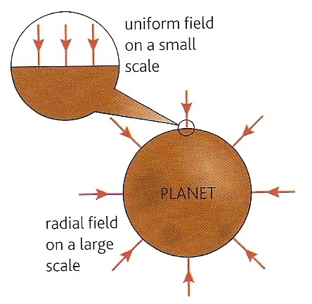
Gravitational fields
These are regions within which an object experiences gravitational force.
They can be represented by lines of force.
Arrows show the direction of the force.
Line density increases with the strength of the field.

Slide 5
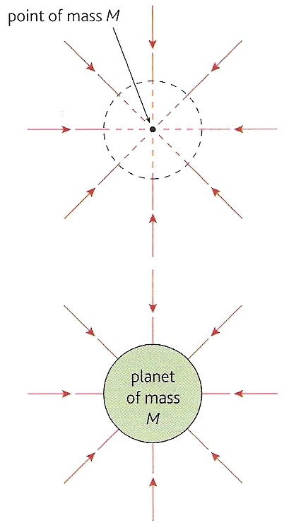
Radial gravitational fields
These exist around point masses.
The field around a uniform sphere, e.g. a planet is also radial.

Slide 6
Field question Draw the field pattern expected between the Earth and the Moon
neutral point
X
EARTH
MOON

Slide 7
Gravitational field strength (g)
This is equal to the force that acts on a very small unit test mass
Definition: g = force g = F
mass m
unit of g: N kg ⁻¹
VECTOR: Direction the same as the force
Earth, sea level average: g = 9.81 N kg⁻¹
Moon, surface average: g = 1.6 N kg⁻¹

Slide 8
Answers:
Complete:
Location | Weight / N | Mass | g / Nkg⁻¹
Earth surface | 9.81 | 1 kg | 9.81
Moon surface | 1.6 | 1 kg | 1.6
Earth surface | 1.0 | 102 g | 9.81
Jupiter cloud top | 96 | 4 kg | 24
Earth surface | 0.491 | 50 g | 9.81
Earth surface | 785 | 80 kg | 9.81
Moon surface | 128 | 80 kg | 1.6

Slide 9
Newton’s law of gravitation (1687)
Every particle of matter in the universe attracts every other particle with a force that is:
1. directly proportional to the product of
their masses
2. inversely proportional to the square of
their distance apart

Slide 10
Mathematically:
F α m₁ m₂
r²
m₁ and m₂ are the masses of the particles
r is their distance apart
Note:
Doubling either mass DOUBLES the force
Doubling both masses QUADRUPLES the force
Doubling the distance apart QUARTERS the force

Slide 11
Inserting a constant of proportionality:
F = - G m₁ m₂
r²
G is called the Universal Constant of Gravitation.
G = 6.672 x 10 ⁻¹¹ N m ² kg ⁻ ².
G is a ‘universal’ constant because it appears to be the same throughout the universe and independent of time, temperature and the medium separating the masses.
G is a very small number and as a consequence gravitational force is only significant when at least one of the masses involved is very large (e.g. at least Moon sized)
The equation contains a negative sign to indicate that the force is attractive.

Slide 12
Question
Calculate the gravitational force between yourself and the person sitting next to you. Comment on your answer.
Typical values:
Masses of both persons = 70 kg
Distance apart = 1m

Slide 13
F = - G m₁ m₂
r²
= (6.672 x 10 ⁻¹¹) x (70) x (70)
(1 )²
gravitational force = 3.72 x 10 ⁻ ⁷ N
Comment:
The weight of one of these persons is about 700N. The above force would be the weight of a mass of about 0.000 04g. This is too small to measure even using a chemical balance reading down to 0.001g.

Slide 14
Radial field relationship between g and G
g = F / m
where m is a mass feeling the gravity force of a much larger mass M
Newton’s law in this situation can now be written:
F = - G M m
r²
Substituting F from the 2nd equation into the 1st: g = - G M m
r² m
g = - G M
r²

Slide 15
Question
Calculate the mass of the Earth, M.
Earth surface g = 9.81 Nkg ⁻¹
Earth radius, r = 6400 km
g = - G M
r²
r = distance from Earth centre = 6 400 000 m = 6.4 x 10 ⁶ m
9.81 = (6.672 x 10 ⁻¹¹) x (M)
(6.4 x 10 ⁶ m )²
M = 9.81 x (6.4 x 10 ⁶ m )² / (6.672 x 10 ⁻¹¹)
= 4.404 x 10¹³ / 6.672 x 10 ⁻¹¹
Earth mass = 6.02 x 10 ²⁴ kg

Slide 16
Question
Calculate the gravitational field strength due to the Earth at:
the top of Snowdon in Wales (height 1000m)
the top of Mount Everest (height 10 000m)
the height of the orbit of the International Space Station (height 300 km)
Earth mass = 6.0 x 10 ²⁴ kg
Earth radius = 6400 km
G = 6.672 x 10 ⁻¹¹ N m ² kg ⁻ ²

Slide 17
g = - G M
r²
Snowdon:
r = distance from Earth centre = (6400 + 1) km
g = (6.672 x 10 ⁻¹¹) x (6.0 x 10 ²⁴ kg)
(6401 x 10 ³ m )²
= 4.003 x 10¹⁴ / 4.097 x 10¹³
g, Snowdon = 9.77 Nkg⁻¹
(b) Everest: r = 6410 km
g, Everest = 9.74 Nkg⁻¹
(c) ISS: r = 6700 km
g, International Space Station = 8.92 Nkg⁻¹

Slide 18
The orbit of the Moon
Calculate the gravitational field strength due to the Earth at the Moon and hence calculate the expected orbital period of the Moon.
Earth mass = 6.0 x 10 ²⁴ kg; Earth radius = 6400 km
Moon orbital radius = 400 000 km;
G = 6.672 x 10 ⁻¹¹ N m ² kg ^{– 2}
g = - G M
r²
g = (6.672 x 10 ⁻¹¹) x (6.0 x 10 ²⁴ kg)
(400 000 x 10 ³ m )²
= 4.0 x 10¹⁴ / 1.6 x 10¹⁷
g, at the Moon due to the Earth’s gravity = 0.0025 Nkg⁻¹

Slide 19
The force exerted on the Moon by the Earth, F = mg,
where m = the mass of the Moon.
This force is a centripetal force which = mrω²
And so: mg = mrω²
g = rω²
but: ω = 2π / T, where T = the orbital period of the Moon
And so: g = r 4π² / T²
T² = r 4π² / g
= [(4.0 x 10⁸m) x 4π²] / (0.0025 Nkg⁻¹) = 1.579 x 10¹⁰ / 0.0025
T² = 6.317 x 10¹²
T = 2.51 x 10⁶ seconds
Orbital period of the Moon = 29.1 days
NOTE: This result agrees with the observed period of the Moon and therefore supports Newton’s law of gravitation.

Slide 20
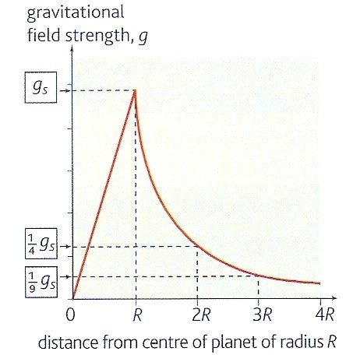
Variation of g with r
INSIDE PLANET
g α r
OUTSIDE PLANET
g α 1
r²

Slide 21
Gravitational potential (V )
The gravitational potential of a point within a gravitational field is equal to the work that must be done per kilogram of mass in bringing the mass from infinity to the point.
Notes:
The gravitational potential at infinity is ZERO.
All other points will have negative potential values.
Gravitational potential is measured in joules per kilogram (J kg⁻¹).
Gravitational potential is a SCALAR quantity

Slide 22
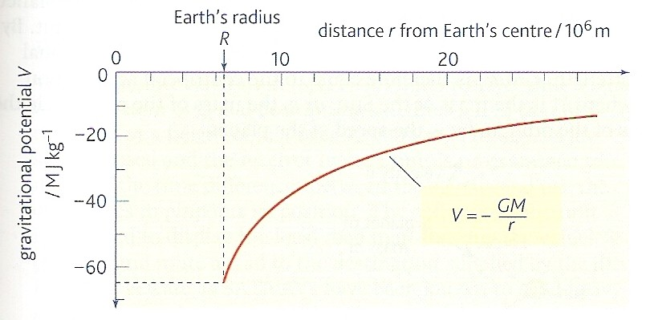
Variation of V about the Earth
V = - G M
r

Slide 23
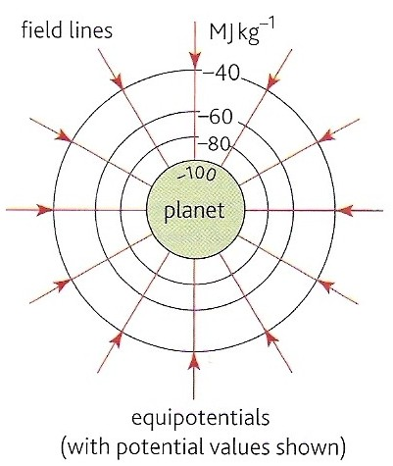
Gravitational equipotentials
These are surfaces that join up points of equal potential.
No work is done by gravitational force when a mass is moved along an equipotential surface.
Equipotentials are always perpendicular to field lines.
Examples include: contour lines on maps, sea level, the floor of a room, the bench top surface.

Slide 24
Gravitational potential difference (ΔV ) and Work (W)
When a mass, m is moved through a gravitational potential difference of ΔV the work done ΔW is given by:
ΔW = m x ΔV

Slide 25
Question
Calculate the minimum work required to lift an astronaut of mass 80kg from the Earth’s surface to the height of the ISS (300 km).
Earth radius, r = 6400 km
Earth mass, M = 6.0 x 10 ²⁴ kg
G = 6.672 x 10 ⁻¹¹ N m ² kg ⁻ ²

Slide 26
V = - G M / r
V at Earth surface: r = 6.4 x 10 ⁶ m
= - (6.672 x 10 ⁻¹¹) x (6.0 x 10 ²⁴ ) / 6.4 x 10 ⁶
= - 6.26 x 10 ⁷ Jkg ⁻¹
V at ISS: r = 6.7 x 10 ⁶ m
= - 5.97 x 10 ⁷ Jkg ⁻¹
ΔV = (6.26 – 5.97) x 10 ⁷ Jkg ⁻¹ = 2.9 x 10 ⁶ Jkg ⁻¹
ΔW = m x ΔV
= 80 kg x 2.9 x 10 ⁶ Jkg ⁻¹
Work = 2.32 x 10 ⁸ J = 232 MJ

Slide 27
Further questions
(a) What work would be needed to remove the astronaut completely from the Earth’s gravitational field?
(b) If this work came from a conversion of initial kinetic energy (the astronaut is projected from the Earth’s surface), what would be the astronaut’s initial speed?

Slide 28
(a) ΔV = (6.26 – 0) x 10 ⁷ Jkg⁻¹ = 6.26 x 10 ⁷ Jkg⁻¹
ΔW = m x ΔV
= 80 kg x 6.26 x 10 ⁷ Jkg⁻¹
Work = 5.01 x 10 ⁹ J = 5 010 MJ
(b) ½ m v ² = ΔW = 5.01 x 10 ⁹ J
v² = (2 x 5.01 x 10 ⁹ J) / 80 kg
v² = (10.02 x 10 ⁹ J) / 80 kg
v² = 1.25 x 10 ⁸
speed, v = 1.12 x 10⁴ ms⁻¹ (11 kms⁻¹)
This is called the escape speed.

Slide 29
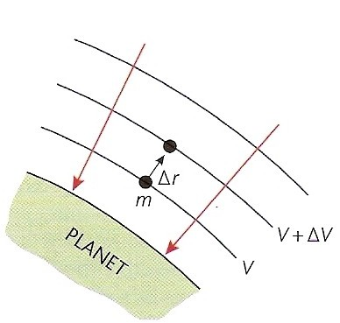
Potential gradient (ΔV / Δr)
This is the change in potential per metre at a point within a gravitational field.
potential gradient = ΔV
Δr
unit: J kg⁻¹ m⁻¹
Near the earth’s surface the potential gradient = 9.81 J kg⁻¹ m⁻¹
g = - ΔV
Δr
There is a negative sign because g acts in the opposite direction to the potential gradient.

Slide 30
Gravitational acceleration and gravitational field strength
The definition of field strength: g = F / m
can be rearranged: F = mg
Newton’s 2nd law: ΣF = ma
If the only force acting on a mass is gravitational then:
ΣF = ma = mg and so: a = g
Therefore in a condition of free fall (only force gravity) the downward acceleration is numerically equal to the field strength.
Near the Earth’s surface:
Gravitational field strength, g = 9.81 Nkg⁻¹
Gravitational acceleration, (also called ‘g’) = 9.81 ms⁻²

Slide 31
Satellite Orbits
A satellite is a smaller mass orbiting a larger one. e.g. The Moon is a satellite of the Earth whereas the Earth is a satellite of the Sun.
In the simplest case the orbit is circular and the centripetal acceleration (v² / r ) of the satellite is numerically equal to the gravitational field strength (GM / r² ) of the larger mass at the position of the satellite.
Projectile & Satellite Orbits - NTNU

Slide 32
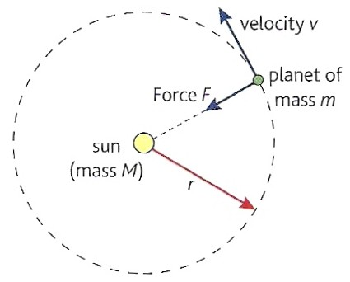
v ² = G M
r r²
rearranging gives:
v = √ (GM / r)
The orbital speed is inversely proportional to the square root of the orbital radius.
For example: Jupiter travels more slowly about the Sun than the Earth.
Kepler Motion - NTNU
Projectile & Satellite Orbits - NTNU

Slide 33
Centripetal acceleration also = r ω²
Where the angular speed ω = 2π / T
T = the period, the time for one complete orbit
Therefore centripetal acceleration = r 4π² / T²
But for an orbit: 4π² r = GM
T² r²
Hence:
T = √ (4π² r ³/GM)
The orbital period is directly proportional to the square root of the orbital radius cubed.
For example: Jupiter takes longer to orbit the Sun than the Earth.

Slide 34
Question
Calculate (a) the orbital speed and
(b) period of the International Space Station.
Earth radius, R = 6400 km
Orbital height of the ISS, H = 300 km
Earth mass, M = 6.0 x 10 ²⁴ kg
G = 6.672 x 10 ⁻¹¹ N m ² kg ⁻ ²

Slide 35
(a) Orbital speed
v = √ (GM / r)
BUT: r = R + H = (6400 + 300)km = 6700 km = 6.7 x 10⁶ m
and so: v = √ (6.672 x 10 ⁻¹¹ x 6.0 x 10 ²⁴ / 6.7 x 10⁶)
= √ (4.003 x 10 ¹⁴ / 6.7 x 10⁶)
= √ (5.975 x 10 ⁷)
orbital speed = 7.73 x 10³ ms⁻¹ = 7.73 kms⁻¹
(b) Orbital period
T = √ (4π² r ³ / GM)
= √ (4π² x (6.7 x 10⁶)³ ) / (6.672 x 10 ⁻¹¹ x 6.0 x 10 ²⁴)
= √ (1.187 x 10 ²² / 4.003 x 10 ¹⁴)
= √ (2.966 x 10 ⁷)
orbital period = 5.45 x 10³ s = 90.8 minutes = 1h 30 mins

Slide 36
Question
Calculate the orbital radius of an Earth satellite having an orbital period of 24 hours.
Earth mass, M = 6.0 x 10 ²⁴ kg; G = 6.672 x 10 ⁻¹¹ N m ² kg ⁻ ²
T = √ (4π² r ³ / GM)
rearranged becomes: r ³ = T ² GM / 4π²
r ³ = (24 x 60 x 60)² x (6.672 x 10 ⁻¹¹ x 6.0 x 10 ²⁴ ) / 4π²
r ³ = (86400)² x (4.003 x 10 ¹⁴) / 4π²
r ³ = (7.465 x 10 ⁹ ) x (4.003 x 10 ¹⁴) / 4π²
r ³ = 7.570 x 10 ²²
r = 4.23 x 10 ⁷ m = 42 300 km
This is 35 900 km above the Earth’s surface

Slide 37
Geosynchronous orbit
This is an orbit about the Earth where a satellite remains above a constant point on the Earth’s surface
Use: Satellite TV transmissions
Such an orbit will:
HAVE A PERIOD OF 24 HOURS
BE OF HEIGHT ABOUT 36 000 KM ABOVE THE EARTH’S SURFACE
BE CIRCULAR
BE EQUATORIAL (in the plane of the equator)
BE IN THE SAME DIRECTION AS THE EARTH’S ROTATION

Slide 38
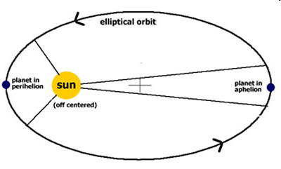
Orbits and energy
Most orbits are elliptical.
The total energy of the satellite remains constant so that at all times:
KE + PE = a constant
at perihelion (closest approach) the KE is max and the PE min resulting in the satellite moving at its highest speed.
at aphelion the PE is max and the KE is min - the satellite moves at its lowest speed.
Kepler Motion - NTNU
Projectile & Satellite Orbits - NTNU

