Slide 1
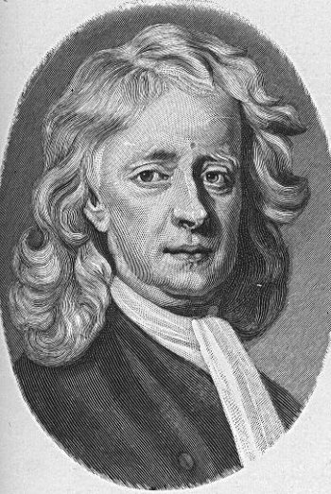
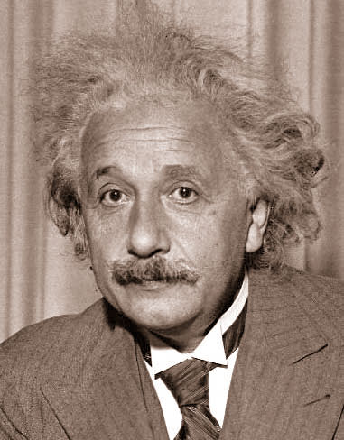
Gravity
Understand the math behind the force
Newtonian
reliable and simple
fails on the “Grand” scale of the galaxy
Einstein’s Theory of Relativity
Relates gravity to “fabric” of space and time
Complex math – not needed for daily experience
Today – still exploring
String theory
Dark Energy

Slide 2
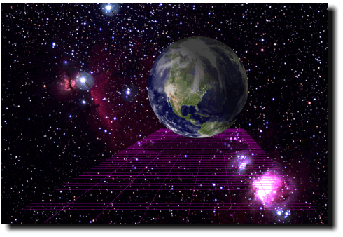
Law of Universal Gravitation
Gravity force is related to masses of two bodies and the distance
FG α mM/r²
Center-to-Center attraction between all forms of matter

Slide 3
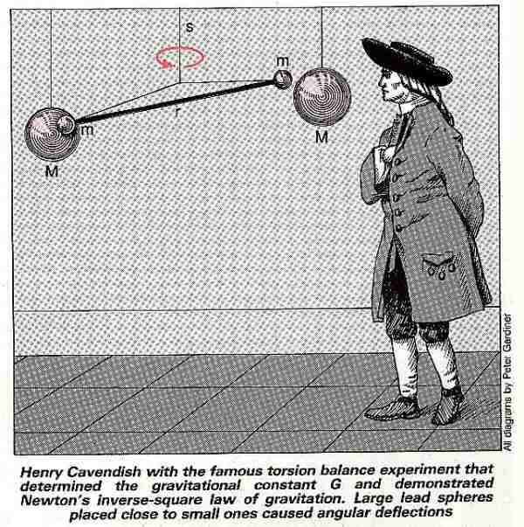
Henry Cavendish’s experiment determined the proportionality constant G in 1798.
http://www.newscientist.com/data/images/archive/1639/16390101.jpg

Slide 4
The Value of G.
G= 6.67 x 10⁻¹¹ N m² / kg²

Slide 5
But G is so small…
Only really noticed when one of the masses is REALLY BIG
Unlimited range
Purely attractive – not weakened by repulsion

Slide 6
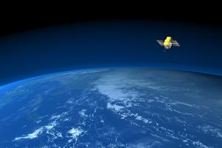
Cool Conclusions
Cavendish wanted to find the density of earth when he did his “G” experiment
g(surface) = GM/R² (solve for M → D=M/V)
Newton (although he didn’t have Cavendish’s experiment) made a guess at density to come up with “g” for earth

Slide 7
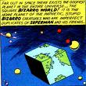
Imperfect Earth
Not a uniform sphere
Hills and valleys
Bulge at the North (pear-shaped)
The spin of earth “throws” the center out
Moon interferes
Gravity is not constant everywhere

Slide 8
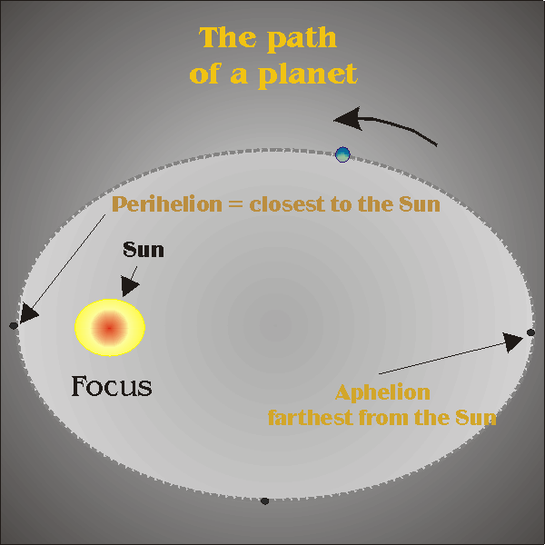
Laws of Planetary Motion
First Law– The planets move in elliptical orbits with the Sun at one focus
The orbits are NEARLY circular, but an oval makes a difference

Slide 9
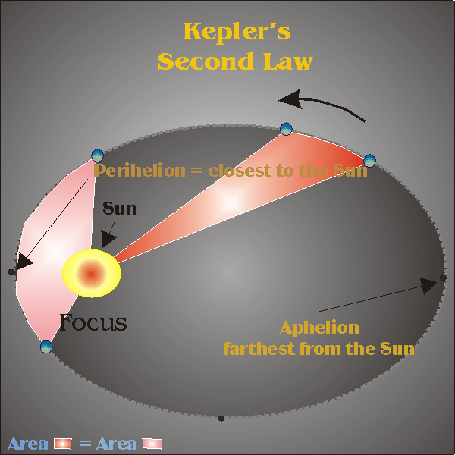
Laws of Planetary Motion
Second Law- As a planet orbits the Sun it moves in such a way that a line drawn from the Sun to the planet sweeps out equal areas in equal time intervals

Slide 10
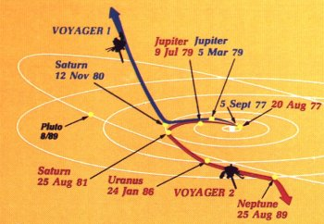
Second law
The speed will be greater when near the sun
As it moves away, gravity slows it down
Idea is used to “sling-shot” rockets and probes through space

Slide 11
Laws of Planetary Motion
Third law – The ratio of the average distance from the Sun cubed to the period squared is the same constant value for all planets
r³/T² = C
r – distance to Sun
T – time to travel around the Sun
C – Solar Constant*
*Different constants for sun, earth, other planets or stars

Slide 12
Third law

Slide 13
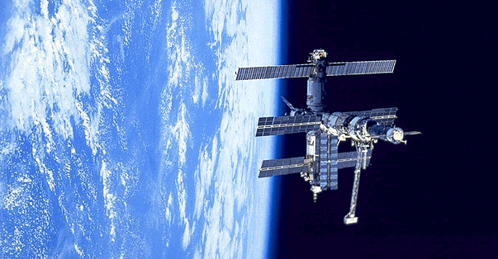
Satellite Orbits
Projectiles – Sail in a parabola until it hits the earth
Fire it faster – go farther
Finally – the earth would “fall away”

Slide 14
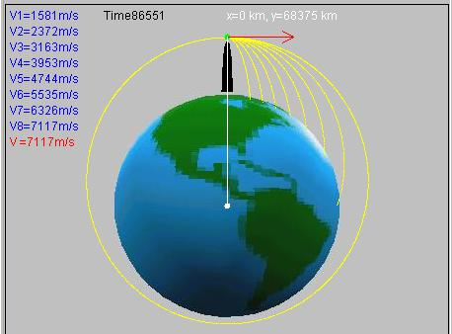
Different Velocities

Slide 15
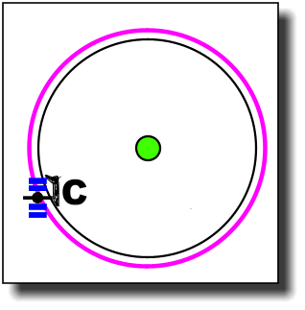
Recall: Orbital speed
When centripetal force equals gravitational force – the object stays in orbit
GmM/r² = mv²o/r
Simplified
vo = √GM/r
Circular orbital speed

Slide 16
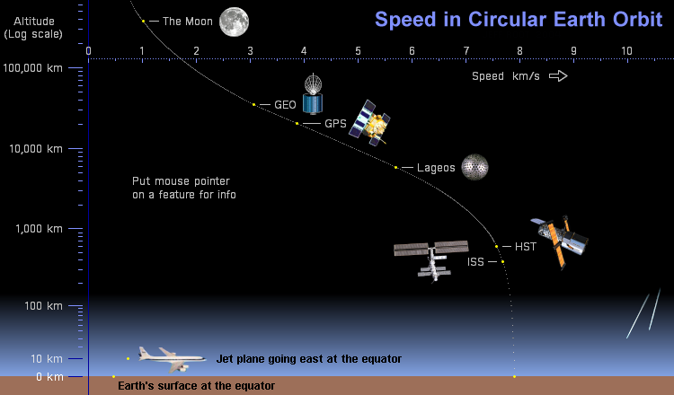

Slide 17
Varying Orbitals
If the velocity is more or less than the circular orbital
Circle : speed v = vo
Elliptical : speed v < vo
Large elliptical :
speed v > vo and < √2vo
Parabola :v = √2vo
Hyperbola : v > √2vo

Slide 18
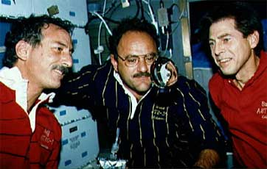
Effectively Weightless
When in free-fall, you have no weight
If you stand on a scale in a free falling elevator
The scale would drop to zero
No normal force pushing back-up
Only gravity is acting

Slide 19
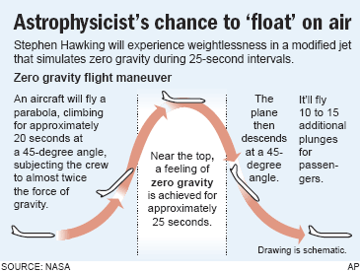
Vomit Comit

Slide 20
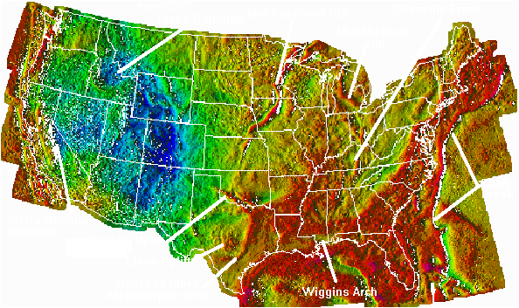
Gravitational Field
When an object experiences forces over a continuous range of locations
Graviton – hypothetical massless carrier of gravitational interaction
Gravity – elusive study in physics

