Slide 1
http://phet.colorado.edu/en/simulation/circuit-construction-kit-dc

Slide 2
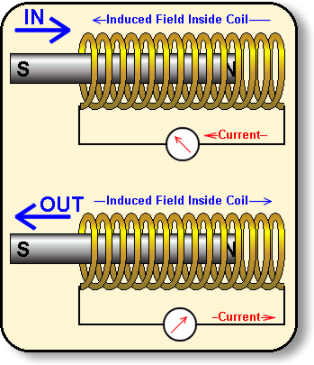
Electromagnetic induction
If a magnet is moved inside a coil an electric current is induced (produced)

Slide 3
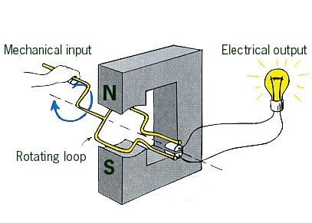
Generator/dynamo
A generator works in this way by rotating a coil in a magnetic field (or rotating a magnet in a coil)

Slide 4
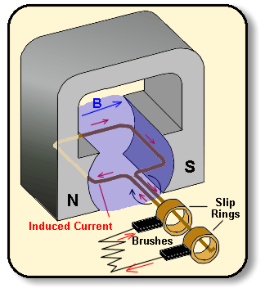
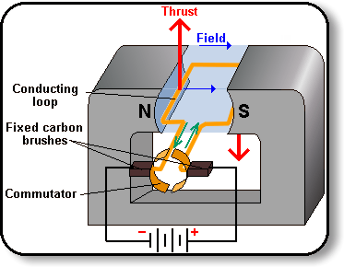
Motor = generator
If electric energy enters a motor it is changed into kinetic energy, but if kinetic energy is inputted (the motor is turned) electric energy is produced!

Slide 5
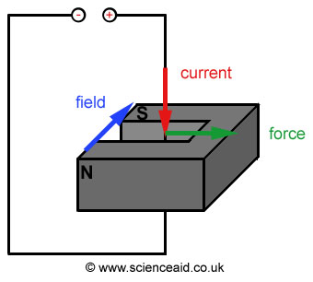
The Motor Effect
When a current is placed in a magnetic field it will experience a force (provided the current is not parallel to the field). This is called the motor effect.
Can you copy this sentence into your books please.

Slide 6
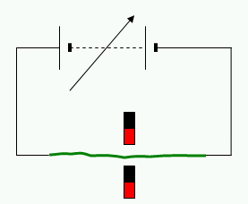
Recall: Third right hand rule Sample question
In this example, which way will the wire be pushed? (red is north on the magnets)

Slide 7
Sample question
In this example, which way will the wire be pushed? (red is north on the magnets)
Current
Field

Slide 8
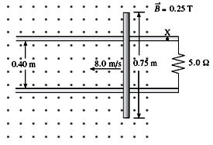
The EMF Induced in a Conductor
Suppose you have a solid conducting rod of length L placed perpendicular to a uniform B field. The rod is placed on metal rails to form a current loop.
The rod is pulled at a speed v, also perpendicular to the B field, as shown in the picture.

Slide 9
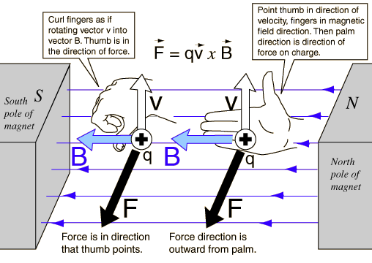

Slide 10
If we imagine a positive charge is located in the wire, we can use the third right hand rule to determine the force it will experience and the direction it will move.
In this case it will move ________.

Slide 11
Positive charges will collect at the top of the bar and negative charges at the bottom, creating a difference in potential (emf) and conventional current will flow clockwise in the loop (through the resistor).

Slide 12
Once the positive charges arrive at the negative end of the rod, work must be done on them for them to move to the positive end, and they experience a change in potential energy from this work.
This work, W=Fd, is done by the magnetic force,
, over the length of the rod L.
Recall from before the change in potential energy is just the charge times the change in potential, by putting these ideas together we get the following:
,
,

Slide 13
Faraday’s Law
Consider a magnet moving through a rectangular plane coil of wire.
N
A
S

Slide 14
Faraday’s Law
A current is produced in the wire only when the magnet is moving.
N
A
S

Slide 15
Faraday’s Law
The faster the magnet moves, the bigger the current.
N
A
S

Slide 16
Faraday’s Law
The stronger the magnet, the bigger the current.
N
A
S

Slide 17
Faraday’s Law
The more turns on the coil (same area), the bigger the current.
N
A
S

Slide 18
Faraday’s Law
The bigger the area of the coil, the bigger the current.
N
A
S

Slide 19
Faraday’s Law
If the movement is not perpendicular, the current is less.
N
A
S

Slide 20
Magnetic Flux (Ф)
Imagine a loop of (plane) wire in a region where the magnetic filed (B) is constant.
B

Slide 21
The magnetic flux (Ф) is defined as Ф = BAcosθ where A is the area of the loop and θ is the angle between the magnetic field direction and the direction normal (perpendicular) to the plane of the coil.
B

Slide 22
If the loop has N turns, the flux is given by
Ф = NBAcosθ in which case we call this the flux linkage.
B
The unit of flux is the Weber (Wb) (= 1 Tm²)

Slide 23
It can help to imagine the flux as the number of lines of magnetic field going through the area of the coil. We can increase the flux with a larger area, larger field, and keeping the loop perpendicular to the field.
B

Slide 24
What we should see from this is that when the magnetic field is parallel to the loop, no field lines pass through the loop and therefore the flux is zero.
Similarly if the magnetic field is perpendicular to the loop, the most field lines possible can pass through the coil and the flux is a maximum.

Slide 25
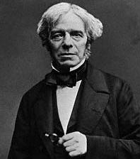
Faraday’s law (at last!)
As we seen, an e.m.f. is only induced when the field is changing. The induced e.m.f. is found using Faraday’s law, which uses the idea of flux.

Slide 26
Faraday’s law
Faraday found that the change in magnetic flux was proportional to the induced emf and expressed it in the following equation:
E = -NΔФ/Δt
N= number of loops,
ΔФ = change in magnetic flux.
The minus sign indicates that the direction of the induced emf is always opposite the change in flux.

Slide 27
Example question
The magnetic field through a single loop of area 0.2 m² is changing at a rate of 4 T.s⁻¹. What is the induced e.m.f?

Slide 28
Example question
The magnetic field (perpendicular) through a single loop of area 0.2 m² is changing at a rate of 4 T.s⁻¹. What is the induced e.m.f?
Ф = BAcosθ = BA
E = ΔФ = ΔBA = 4 x 0.2 = 0.8 V
Δt Δt

Slide 29
Moving Conductor in a Magnetic Field: What causes the potential (voltage) in a conductor to rise
Consider a straight conductor moving with a uniform velocity, v, in a stationary magnetic field.
The free charges in the conductor experience a force which will push them to one end of the conductor.

Slide 31
What causes the potential (voltage) in a conductor to rise cont.
If we imagine a positive charge is located in the rod, we can use the third right hand rule to determine the force it will experience and the direction it will move.
In this case it will move ________.

Slide 32
Positive charges will collect at the top of the bar and negative charges at the bottom, creating a difference in potential (emf) and conventional current will flow clockwise in the loop (through the resistor).

Slide 33
Once the positive charges arrive at the negative end of the rod, work must be done on them for them to move to the positive end, and they experience a change in potential energy from this work.
This work, W=Fd, is done by the magnetic force,
, over the length of the rod L.
Recall from before the change in potential energy is just the charge times the change in potential, by putting these ideas together we get the following:
,
,

Slide 34
Another example question!
There is a uniform magnetic filed B = 0.40 T out of the page. A rod of length L = 0.20 m is placed on a railing and pushed to the right at a constant speed of v = 0.60 m.s-1. What is the e.m.f. induced in the loop?
L
v

Slide 35
The area of the loop is decreasing, so the flux (BAcosθ) must be changing. In time Δt the rod will move a distance vΔt, so the area will decrease by an area of LvΔt
L
v
LvΔt

Slide 36
= ΔФ = BΔA = BLvΔt = BLv
Δt Δt Δt
= 0.40 x 0.20 x 0.60 = 48 mV
L
v
LvΔt

Slide 37
Lenz’s Law
The induced current will be in such a direction as to oppose the change in magnetic flux that created the current.
(This law helps us decide the direction of the induced current)

Slide 38
The reason the induced current always produces a magnetic field that opposes the original change in flux (motion of the bar magnet) is energy conservation.
By moving the magnet in the coil you have to work against the induced current’s opposing magnetic field.
The work you do is transformed into electrical energy in the loop.
If the law was not true, it would imply you wouldn’t need to do work to change the magnetic flux, and where would the induced emf come from?

Slide 39
Generators and Motors
A generator produces current by having some sort of force rotate a coil inside an external magnetic field.
In general you could say it converts mechanical energy to electrical energy, and the mechanical energy is often supplied by falling water or steam pressure.
As the coil rotates in the magnetic field the flux through the coil varies producing an emf that varies creating an alternating current
A motor is basically the opposite of a generator, producing mechanical energy from electrical energy.

Slide 40
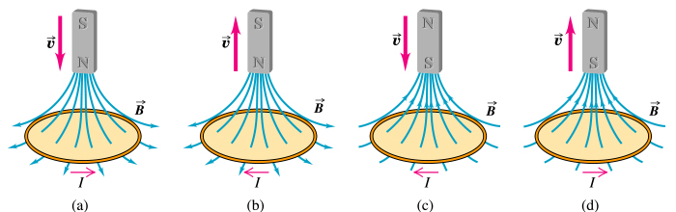
Recall: Induced Currents Caused by Changes in Magnetic Flux
The magnetic flux (number of field lines passing through the coil) changes as the magnet moves towards or away from the coil.
http://micro.magnet.fsu.edu/electromag/java/lenzlaw/index.html

Slide 41
Alternating current
A coil rotating in a magnetic field will produce an e.m.f.
N
S

Slide 42
Slip ring commutator
To use this e.m.f. to produce a current the coil must be connected to an external circuit using a split-ring commutator.
Slip-rings
lamp

Slide 43
Transformers
These are useful devices that can increase or decrease an applied voltage.
They work on the principle of magnetic induction, and for that reason, can only work with AC Current.
This is because DC current cannot generate a change in magnetic flux.

Slide 44
Transformers
A transformer consists of two coils of wire known as primary and secondary coils.
N_{p} turns
V_{p}
V_{s}
N_{s} turns
Primary coil
Iron core
Secondary coil
“Laminated”

Slide 45
Transformers
How do they work?
N_{p} turns
V_{p}
V_{s}
N_{s} turns
Primary coil
Iron core
Secondary coil

Slide 46
An alternating current in the primary coil produces a changing magnetic field in the iron core.
N_{p} turns
V_{p}
V_{s}
N_{s} turns
Primary coil
Iron core
Secondary coil

Slide 47
The changing magnetic field in the iron core induces a current in the secondary coil.
N_{p} turns
V_{p}
V_{s}
N_{s} turns
Primary coil
Iron core
Secondary coil

Slide 48
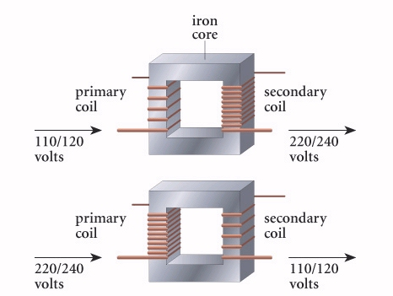

Slide 49
It can be shown using Faraday’s law that:
V_{p}/V_{s} = N_{p}/N_{s} and V_{p}I_{p} = V_{s}I_{s}
N_{p} turns
V_{p}
V_{s}
N_{s} turns
Primary coil
Iron core
Secondary coil

Slide 50
Power transmission
When current passes through a wire, the power dissipated (lost as heat) is equal to
P = VI across the wire
Since V = IR
Power dissipated = I²R

Slide 51
Power transmission
Power dissipated = I²R
Since the loss of power depends on the square of the current, when transmitting energy over large distances it is important to keep the current as low as possible.
However, to transmit large quantities of energy we therefore must have a very high voltage.

Slide 52
Power transmission
Electricity is thus transmitted at very high voltages using step up transformers and then step down transformers.
220 V
Step-down
250,000 V
15,000 V
Step-up
Step-down
15,000 V

