Slide 2
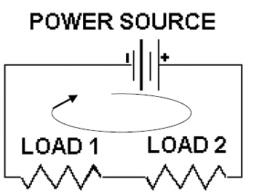
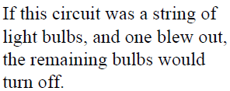
Recall:

Slide 3
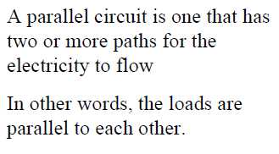
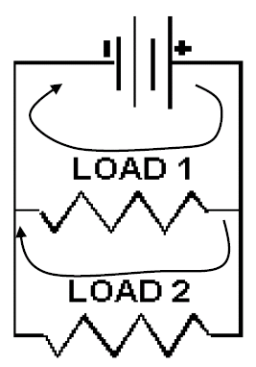

Slide 4
Recall: Ohm’s Law
The current in an ohmic conductor is proportional to the voltage across it, provided that the temperature and other physical conditions are kept constant.
V = R × I
R is the resistance, measured in ohms (Ω).

Slide 5
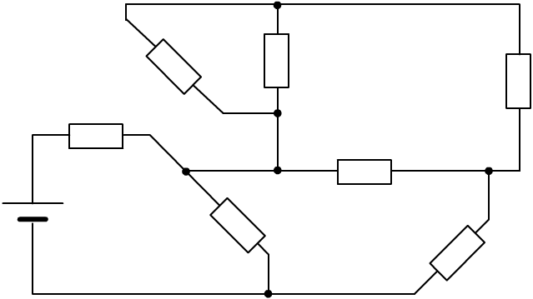
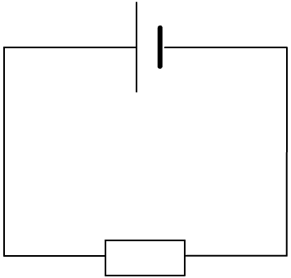
Equivalent resistance
R₂
R₃
R₁
R₄
R₅
R_{T}
R₆
R₇
When designing or analysing circuits, complex combinations of resistors are common. To perform calculations, for example to find a suitable fuse to protect the circuit, it is easier to use a value for the total resistance of the circuit, R_{T}.
R_{T} can be called the equivalent resistance because it is the single resistor that is equivalent to the complex combination.
Notes:
Boardworks AS Physics
Resistance and Resistivity

Slide 6
Resistors in series
To work out the equivalent resistance of resistors in series, the resistor values can just be added together:
10 Ω
20 Ω
15 Ω
equivalent resistance = 10 + 20 + 15
= 45 Ω
In general for a number of resistors, n:
R_{T} = R₁ + R₂ + … + R_{n}
Notes:
Boardworks AS Physics
Resistance and Resistivity

Slide 7
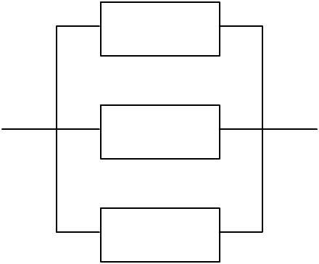
Resistors in parallel
To work out the equivalent resistance for resistors in parallel, a more complex equation must be applied:
1
1
1
1
=
+
+
…
+
R_{T}
R₁
R₂
R_{n}
For example:
1
1
1
1
=
+
+
R_{T}
10
20
15
10 Ω
1
6 + 3 + 4
=
R_{T}
60
1
=
13
20 Ω
R_{T}
60
60
15 Ω
R_{T}
=
Ω
= 4.62 Ω
13
Notes:
Teacher notes
If students struggle with the maths in this example, they could be reminded that to add fractions together, you should first find the lowest common denominator, in this case 60.
Boardworks AS Physics
Resistance and Resistivity

Slide 8
Resistor combinations
Notes:
Teacher notes
Students could be encouraged to draw a diagram for each question before beginning the calculation.
Boardworks AS Physics
Resistance and Resistivity

Slide 9
Kirchhoff’s first law
The German physicist Gustav Kirchhoff established two laws which help us to understand the function of electric circuits.
Kirchhoff’s first law states that:
The sum of the currents leaving any junction is always equal to the sum of the currents that entered it.
This law is based upon the idea of the conservation of charge: no charge can be lost or made in a circuit.
I_{IN}
Thus the sum of the currents at a junction should be zero.
I_{IN} = I₁ + I₂ … + I_{n}
I₁
I₃
ΣI = 0
I₂
Notes:
Boardworks AS Physics
Simple Circuits

Slide 11
The energy in a circuit
What happens to the energy supplied to a circuit?
Batteries and power supplies supply electrical energy to a circuit. Devices within the circuit change this energy to other forms: bulbs produce heat and light, resistors produce heat.
What is the conservation of energy?
Energy cannot be created or destroyed. All of the energy provided by a power supply must be used by the circuit.
How does the voltage of a battery relate to the voltage measured across the devices in a circuit?
Voltage is the energy transferred to the charge in a circuit. The battery’s voltage is shared between the components, which changes this energy into different forms.
Notes:
Boardworks AS Physics
Simple Circuits

Slide 12
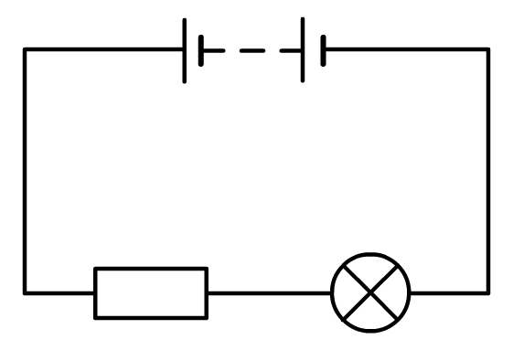
Kirchhoff’s second law
Kirchhoff’s second law is based upon the law of the conservation of energy. It states that:
The total voltage across a circuit loop is equal to the sum of the voltage drops across the devices in that loop.
Essentially, the energy you put into the circuit equals the energy you get out of each circuit loop.
I
V_{IN}
An equation can be produced for each loop in a circuit. For example:
V₁
V₂
V_{IN} = V₁ + V₂
V_{IN} = IR₁ + IR₂
R₁
R₂
Notes:
Teacher notes
In this equation IR is derived from the equation V = I × R.
Boardworks AS Physics
Simple Circuits

Slide 13
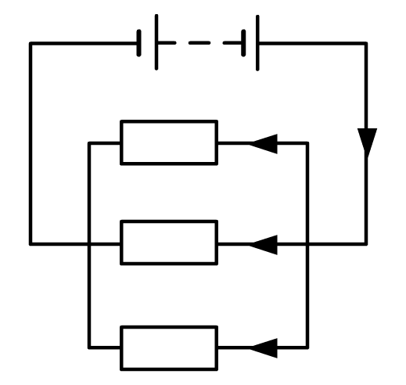
Further uses for Kirchhoff’s law
Use Kirchhoff’s laws to find the values for each current.
E = 12 V
There are 3 loops in the circuit. Each has a voltage drop equal to the input voltage according to the 2nd law.
V₁
I₁
10 Ω
I
Therefore: E = V₁ = V₂ = V₃
V₂
I₂
The 1st law means that current entering each junction equals the current leaving.
100 Ω
V₃
I₃
40 Ω
Therefore: I = I₁ + I₂ + I₃
V
12
12
12
As I =
I =
+
+
I = 1.2 + 0.12 + 0.3
R
10
100
40
I = 1.6 A
I₁ = 1.2 A
I₂ = 0.1 A
I₃ = 0.3 A
Notes:
Boardworks AS Physics
Simple Circuits

