Slide 1
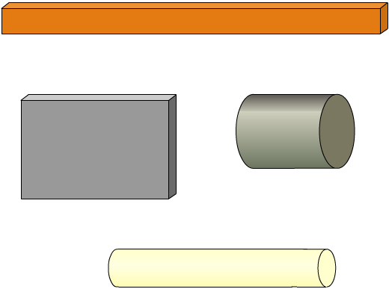
What is resistivity?
Which of the four examples below has the largest resistance, and which has the smallest?
The resistance depends on the size and shape of the material (its cross-sectional area and length) and the material itself.
copper
silver
The measure of how much a particular material opposes electron flow is called the resistivity of the material.
silicon
plastic
Notes:
Boardworks AS Physics
Resistance and Resistivity

Slide 2
Introducing the resistivity equation
Resistivity is usually given the symbol ρ (the Greek letter rho). Resistivity is calculated using the following equation:
resistance × cross-sectional area length
resistivity =
RA L
ρ =
The units of resistivity are ohm metres (Ωm).
Resistivity for a particular material varies with temperature, so it is usually quoted for a particular temperature. This is because resistivity depends on resistance, and resistance varies with temperature.
Notes:
Teacher notes
Resistivity should not be confused with density, which is also given the symbol ρ.
Boardworks AS Physics
Resistance and Resistivity

Slide 5
Electromotive force or EMF is the term given to the energy per unit charge by a source of emf such as a voltaic cell or electrical generator. It is basically the potential difference across a cell or other power supply.

Slide 6
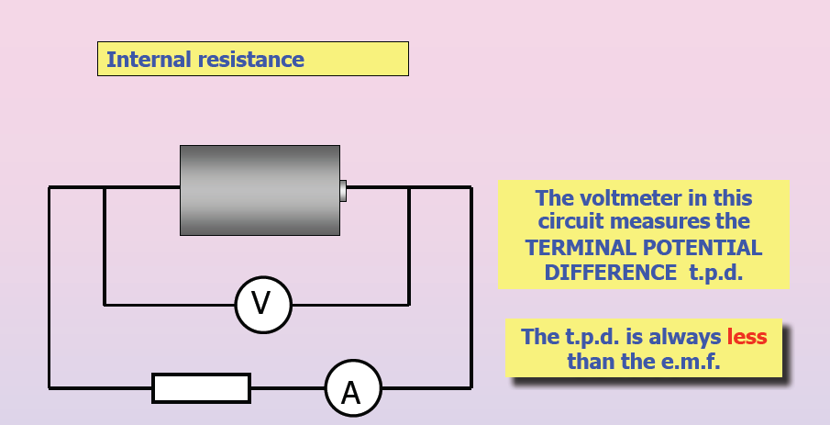
Internal resistance

Slide 7
How to solve problems involving internal resistances
Step 1: Get the net external resistance R_{t} in the circuit.
Step 2: Find the current leaving the battery
i. You can directly measure it using an ammeter
ii. You can get it using I = V_{t} / R_{t} if you know the terminal voltage
iii. In the ideal case only (r = 0), you can use I = EMF / R_{t}
iv. Put the internal resistor in series with R_{t} then you find I = EMF /( R_{t} + r)
Step 3: Use the relationship V_{t} = EMF - Ir and solve for the desired quantity.

Slide 8
Electrical Power
When current flows through a circuit, electrical potential energy changes form as it passes through the different components.
As it passes through a light bulb the potential energy is changed into light and into _____________.
The rate at which electrical energy changes form is called the electrical power.

Slide 9
Since the amount of charge divided by the time is the ____________,
equation becomes time:
By substituting Ohm’s law the following can be derived for power through resistors:
Power is in the units of Watts where 1 Watt is a Joule per second.

