Slide 1
Momentum
Objectives :
To know the properties of momentum.
To be able to manipulate the equation used for momentum.

Slide 2
Starter:
Write down the unit of each of the following in your notebook:
a=
d=
v=
t=
m=
F=

Slide 3
Momentum
Momentum = mass x velocity
p=mv
Units?
Unit of p = unit of m X unit of V
= kg X m/s
= kgm/s or
= kg m s‾¹

Slide 4
Momentum
Is a vector quantity so direction is important (ie can be negative)
In any collision or interaction Momentum is always conserved

Slide 5
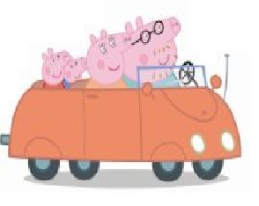
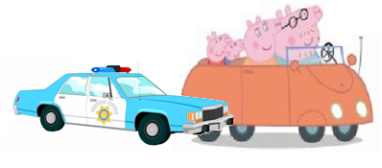
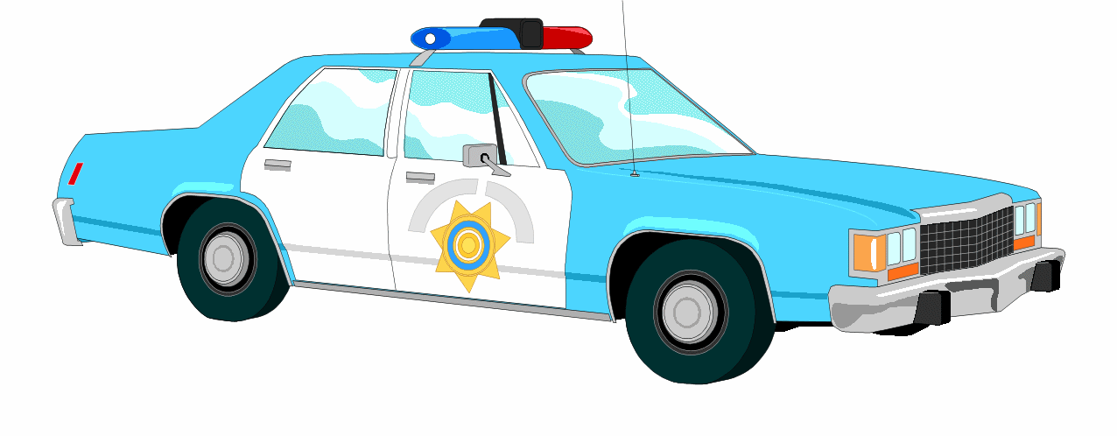
Momentum is always conserved:
The total momentum of two objects before they collide is equal to the total momentum after the collision.
momentum before = momentum after
p₁ + p₂ = p_{total}
100kgms⁻¹
200kgms⁻¹
300kgms⁻¹

Slide 6
Example 1:
A skater of mass 75kg and velocity of 4ms⁻¹ collides with a stationary skater of mass 50kg. Calculate their velocity after impact.
Momentum before collision =
75kg X 4ms⁻¹
+ 0
=300kgms⁻¹
Momentum after collision =
(75 + 50) kg X v
300kgms⁻¹
= (75 + 50) kg X v
v = 300kgms⁻¹ /(75 + 50) kg
v = 2.4ms⁻¹

Slide 7
Example 2:
A bullet of mass 5 g is shot from a rifle at a speed of 200ms⁻¹ The rifle has a mass of 4kg. Calculate the velocity at which the rifle recoils.
Momentum before firing =
0
Momentum after firing=
Momentum of bullet + momentum of rifle
= 0
➔ 0.005 kg × 200ms⁻¹
+ 4 kg×(v)=0
➔ 1kgms⁻¹+4kgv=0
➔ v= - 1kg ms⁻¹ /4kg
v = -0.25ms⁻¹
Since, v= -0.25 ms⁻¹ then the velocity of the rifle was in the opposite
direction of the velocity of the bullet.

Slide 8
Why is it true?
In any collision the force between them is the same and acts for the same time (Newton’s 3)
This force acts on different objects however and will accelerate each object differently according to the mass of each (Newton’s 2 )
The final velocity reached by each object will decrease in the same proportion as the mass of the objects increases
The product m x v for each object is therefore identical

Slide 9
Why is this useful?
It allows us to predict the outcome of collisions eg car rail and air accident simulations and construct vehicles to stand up to them better
It allows us to calculate the speed of objects which would otherwise be difficult eg the speed of a shell or rifle bullet
It might allow us to become excellent snooker players but……..

Slide 10
Try these…..
1. A trolley of mass 4kg moving at 10 m/s collides with a 2 kg trolley moving in the same direction at a velocity of 4m/s. they separate after the collision and the 4 kg trolley slows to 7m/s. What is the final speed of the other trolley? (hint draw diagrams of momentum before and after)
2. a trolley A of mass 1kg is travelling at 2m/s towards another trolley B of mass 4kg which is travelling towards it at a velocity of 3m/s. On collision they stick together. What is their final combined velocity and in which direction do they travel together? (care with negatives)
10m/s
2m/s to the left

Slide 11
1. What is the momentum in kg.m.s⁻¹ of a 10 kg truck traveling at
i. 5 m.s⁻¹ ii. 20 cm.s⁻¹ iii. 36 km.h⁻¹
2. Jack, whose mass is 48 kg, is running at 5 m.s⁻¹ and jumps onto a 7 kg skateboard moving in the same direction at 3.0 m.s⁻¹. What is their speed after Jack is on the skateboard?
3. A truck of mass 500 kg moving at 4 m.s⁻¹ east collides with another truck of mass 1500 kg moving at 1.5 m.s⁻¹ west. What is their common velocity after the collision if they stick together? (Hint: Make one of the velocities negative)
Difficult question for physics geniuses only
4. A comet of mass 1 x 10⁶ kg hits the earth at a speed of 1 x 10⁵ m.s⁻¹. At what speed does the earth move backwards after the collision (mass of earth = 700 x 10²² kg)? (Assume that the earth is not moving before the collision, a big assumption!)

