Slide 1


Review:
We have learned about many forces that can act on an object.
If someone pushes on an object we usually call this force an ________________ force and give it the symbol .
If two things are touching and they are moving relative to each other there is a force that acts to slow them down called the force of ______________, it is given the symbol and this force is always opposite the motion.
If an object is forced against a surface but does not accelerate, there is a force that acts to keep it in equilibrium called the _______________ force.
The normal forces is always at 90º to the surface.
If an object is given a force that distorts or ________ its shape, it will try to restore itself to its original shape once the applied force is removed.
The force that acts to restore the object to its original shape is called the __________________ or ________________ force and is given the symbol .
Last but not least, there is a force that acts to pull you towards the Earth called the force of ________ and its is given the symbol .
applied force
friction
normal forces
changes
restoring force
elastic force
gravity

Slide 2
Purpose:
Today we will re-examine the force of gravity and see how what we have learned about this force is only an approximation for objects on Earth.

Slide 3
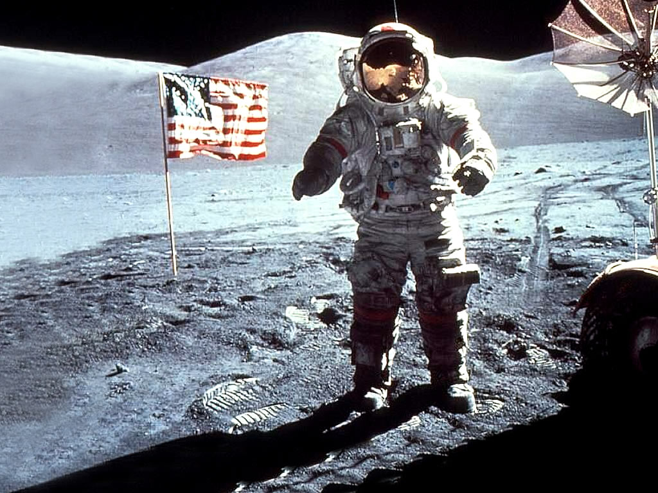
Gravity
A force of attraction between objects that is due to their masses.
Because gravity is less on the moon than on Earth, walking on the moon’s surface was a very bouncy experience for the Apollo astronauts.

Slide 4
All Matter Is Affected by Gravity
All objects experience an attraction toward all other objects.
Because of gravity you are being pulled toward this book, your pencil, and every other object around you. Do you know why?

Slide 5
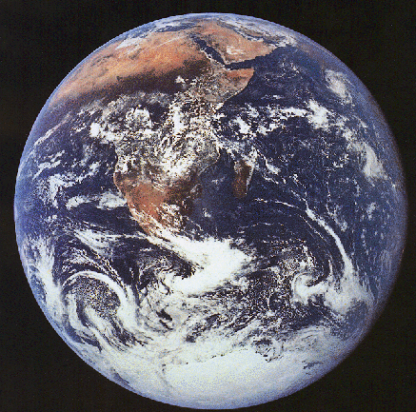
Earth’s Gravitational Force Is Large
“It’s Truly Incomparable”
Compared with “all” the objects around you, Earth has a enormous mass.

Slide 6
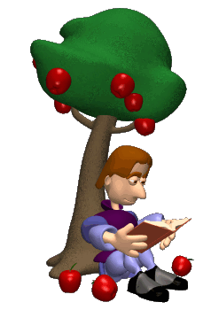
The Law of Universal Gravitation
Why do objects fall toward Earth?
What keeps the planets in motion in the sky?
Newton Makes the Connection

Slide 7
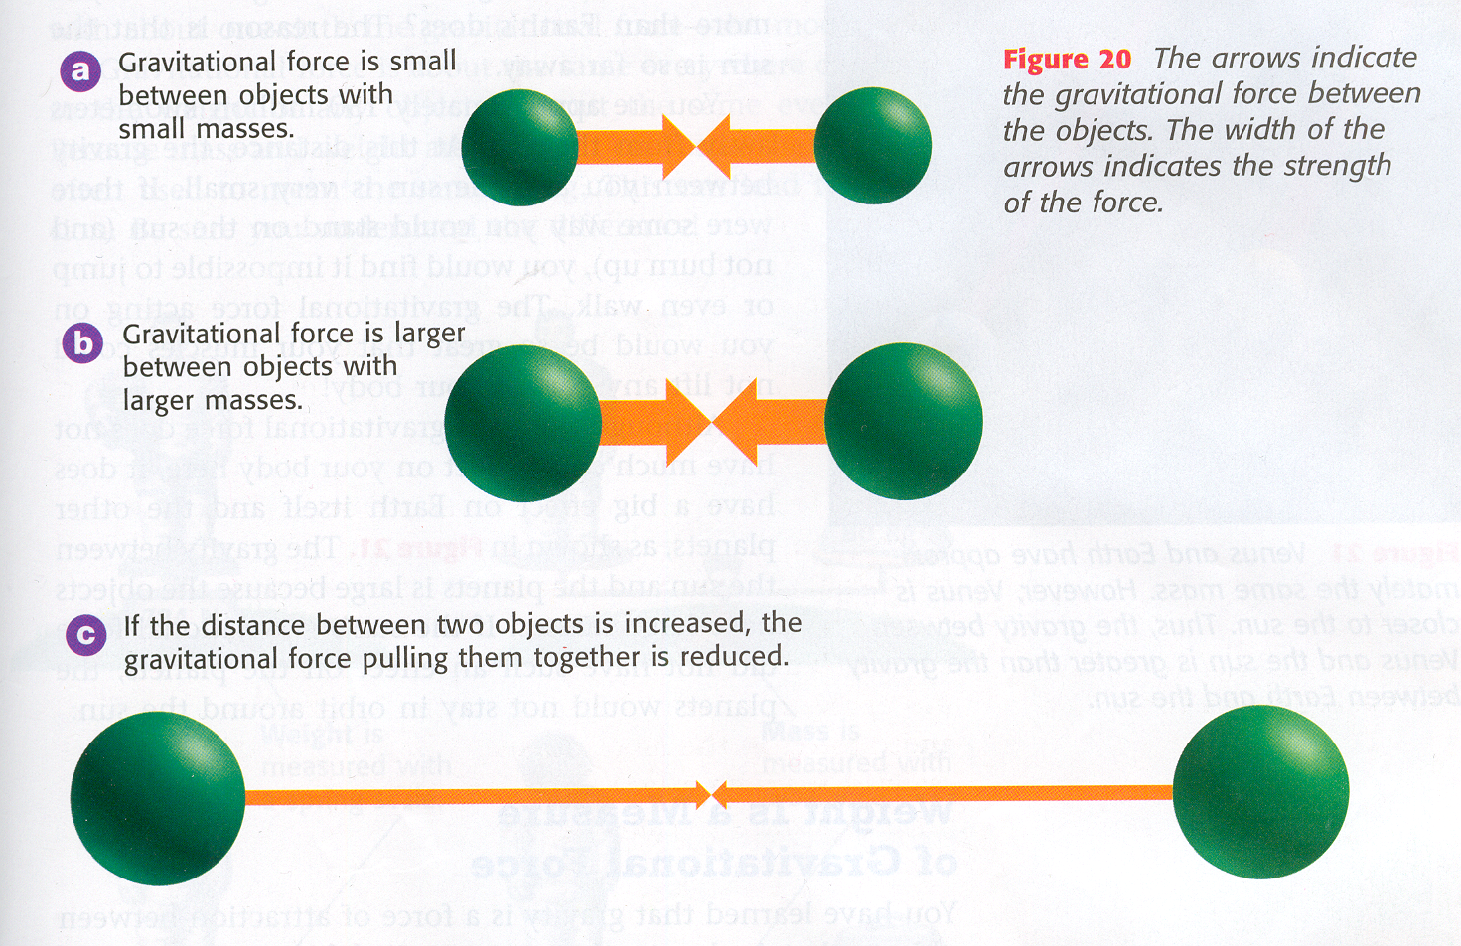
The Law of Universal Gravitation states that all objects in the universe attract each other through gravitational force. The size of the force depends on the masses of the object and the distance between them.

Slide 8
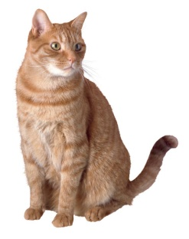
For Example…
Gravitational force increases as
mass increases.
  Imagine an Elephant and a Cat
  Or imagine the Earth and the Moon
Gravitational force decreases as distance increases.
  Gravity between you and the Earth
  Gravity between you and the Sun

Slide 9
Newton’s Law of Gravity
D
1
2
F_{g}
F_{g}
m₁ = Mass of object 1 (kg)
m₂ = Mass of object 2 (kg)
r = Distance between objects (m)
G = 6.67x10⁻¹¹ N m²/Kg²

Slide 10
Ex 1: A 68.0 kg boy looks up across the class room and sees a 45.0 kg girl 3.50 meters away. He feels a strange attraction between himself and the girl and thinks it is the universal force of gravity. Calculate the size of the force of gravity between them.

Slide 11
Ex 1
Given:
m_{b} = 68.0 kg
m_{g} = 45.0 kg
r = 3.50 m
G = 6.673 x 10⁻¹¹ Nm² kg⁻²
= (6.673 x 10⁻¹¹ Nm² kg⁻² ) (68.0 kg) (45.0 kg )
(3.50 m) ²
= 1.67 x 10⁻⁸ N
Therefore, the size or magnitude of the attraction is 1.67 x 10⁻⁸ N
It pulls the boy in the ______ direction and pulls the girl in the ______ direction.
girls
boys

Slide 12
Practice questions
Ex:2
Given:
Fg = 3.33 x 10⁻⁷ N
r = 1000.0 m
M₁= 2M₂
G = 6.673 X 10‾¹¹ Nm²kg‾²
Find m.

Slide 13
Gravitational field strength
The force of gravity that we have used before is a very good approximation for the universal force of gravity on the Earths surface.
is the force of the earth on object 1.
We learned today:
Lets say: m₁ = Mass of object 1
m₂ = Mass of the Earth
We know
Therefore:
or

Slide 14
Since the radius of the Earth is very large and it’s square is even larger! Changing your height above the surface of the Earth doesn’t change the value of g very much.
Ex4: Calculate the gravitational field strength on the Earth’s surface and on a 400.0 meter tall building. What is the difference in the field strengths?
Radius of the Earth is 6378100 m
and the mass of the Earth is 5.9742 x 10²⁴ kg
Since the difference in gravitational field strength is very small on the Earth’s surface, using the acceleration of gravity as 9.80 m/s² is not a problem on the Earth’s surface.

