Slide 1
Recall: Different forms of the power equation
Electrical power can also be calculated using resistance.
The equations linking power to resistance are found by substituting the equation V = I × R into the power equation:
P = V × I
P = V × I
and… V = I × R
and… I = V ÷ R
Therefore, using substitution:
Therefore, using substitution:
P = I × R × I
P = V × V ÷ R
P = I² × R
P = V² ÷ R

Slide 2
Recall:
I = Q /t ➔ Q = It
Therefore: Ep= I t V

Slide 3
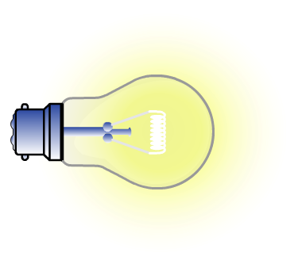
Efficiency
Efficiency is a measure of how well a device transforms energy into useful forms.
A light bulb converts electrical energy to useful light and wasted heat.
light
electrical
heat
What is the efficiency of the bulb if it converts 50 J of electrical energy into 45 J of heat energy?
useful energy out
efficiency =
× 100
total energy in
5
=
× 100
= 10 %
50

Slide 4
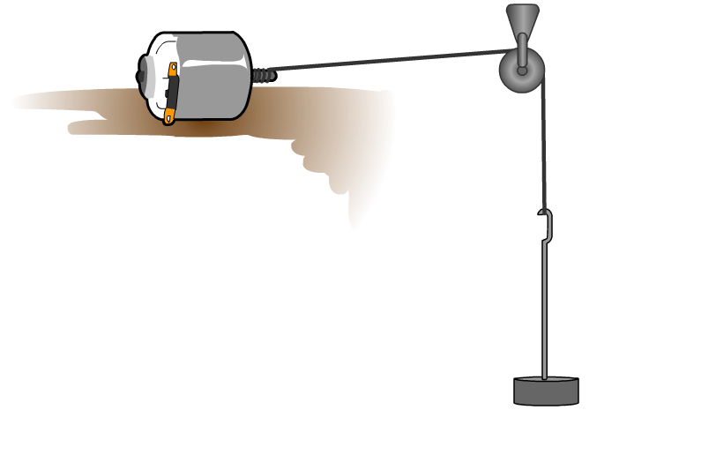
Efficiency of a motor
What is the efficiency of this system, if the motor takes 5 seconds to lift the weight?
(take gravity to be 9.81 N/kg)
6 V
2 A
pulley
motor
1.5 m
energy into system:
electrical energy = I × t × V
= 2 × 5 × 6
= 60.0 J
1.4 kg
energy used:
gravitational potential energy = m × g × h
= 1.4 × 9.81 × 1.5
= 20.6 J
useful energy out
20.6
efficiency =
× 100
=
× 100
= 34.3 %
total energy in
60.0

