Slide 1
Uniform Circular Motion
A special kind of two-dimensional problem involves objects undergoing uniform circular motion.
Uniform circular motion is motion in a circle at a constant speed.

Slide 2
Circular Motion
Kinematics of Uniform Circular Motion
(Description of Uniform Circular Motion)
Dynamics of Uniform Circular Motion
(Why does a particle move in a circle?)

Slide 3
Circular Motion
B
A
C
B: Tangent to the Circle
A ball is going around in a circle attached to a string. If the string breaks at the instant shown, which path will the ball follow?
16
Notes:
Use this to motivate circular motion involves acceleration.

Slide 4
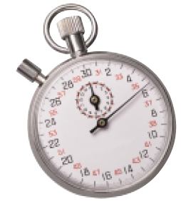
An analogue stopwatch — calculating average acceleration
A track coach starts an analogue stopwatch and allows it to run for one minute. If the sweep second hand on the stopwatch is 2.0 cm in length, determine
a) the speed of the sweep second hand.
Solution and Connection to Theory
Given
a) To determine the speed of the sweep second hand, we can use the
defining equation for speed,
which can be modified to
where C is the circumference of the stopwatch, in metres, and
T is the period, in seconds.

Slide 5
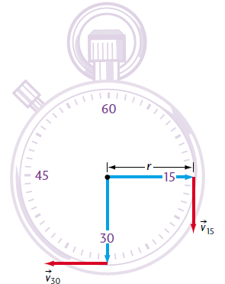
b) the velocity of the sweep second hand at the 15-s point. c) the velocity of the sweep second hand at the 30-s point.
b) Now that we know the speed of the sweep second hand, we only need to determine the direction for velocity.
At t 15 s, the second hand is moving down.
Therefore, the velocity of the sweep second hand at t = 15 s is:

Slide 6
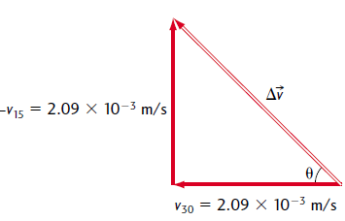
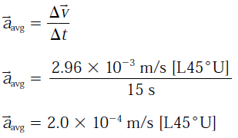
d) the average acceleration of the sweep second hand between the 15-s and 30-s points.
➔ To determine the average vector acceleration, we can use our defining equation for acceleration,

Slide 7
From this example, we can note two things.
First, remember that acceleration is a vector.
The magnitude of the velocity (i.e., the speed) need not change in order for acceleration to occur; it is sufficient that there is a change in direction, as in this case.
As a result, we have acceleration.

Slide 8
Second, what is the direction of the average acceleration?
In Example, the direction is [L45°U]. This value is the average acceleration over the 15-s time interval.
Therefore, it is also the direction of the instantaneous acceleration at the midpoint of the arc between t = 15 s and t= 30 s.
More precisely, it is the direction of the instantaneous acceleration at t= 22.5 s.
At this point, the instantaneous acceleration is directed toward the centre of the circle; that is, the acceleration is centre-seeking or centripetal.
Whenever an object is undergoing uniform circular motion, it undergoes centripetal acceleration (i.e., directed toward the centre of the circle).

Slide 9
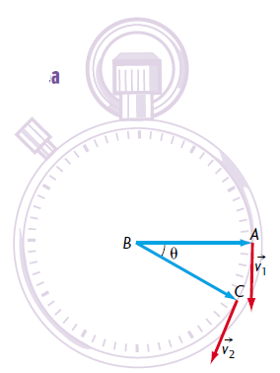
The magnitude of centripetal acceleration is constant, however
its direction changes every instant so that it is always directed toward the centre of the circle.
Derive an algebraic equation for the magnitude of centripetal acceleration.
Figure a shows a stopwatch with a sweep second hand and two velocity vectors, v1 and v2, at times t1 and t2, respectively.
As the sweep second hand rotates from point A to point C in Figure a, it sweeps out an angle,𝜽 .

Slide 10
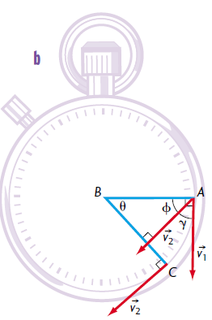
Figure b shows both vectors, v1 and v2, drawn from the same point.
The angle 𝜸 represents the change in the velocity vector’s direction as the second hand’s velocity changes from point A to point C.
Since the radii BA and BC
are both perpendicular to the tangential velocities v1 and v2,
Therefore, angles 𝜽 and 𝜸 must be equal.

Slide 11
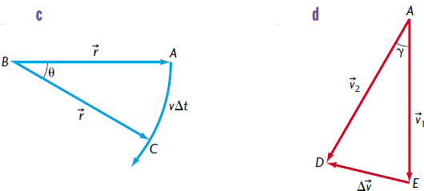
As the second hand sweeps through a change in time ∆t, it sweeps through an arc of length v∆t (Figure c).
As t approaches zero, the angle also approaches zero, and the arc swept out by the second hand gets smaller and smaller and eventually approaches a straight line.
The triangle DAE, shown in Figure d, is an isosceles triangle.
The vector v is its base.
Because angles 𝜸 and 𝜽 are equal, triangles CBA and DAE are similar triangles.
Since v1 = v2 = v,

Slide 12
is the equation for acceleration.
Therefore, the magnitude of centripetal acceleration,

Slide 13
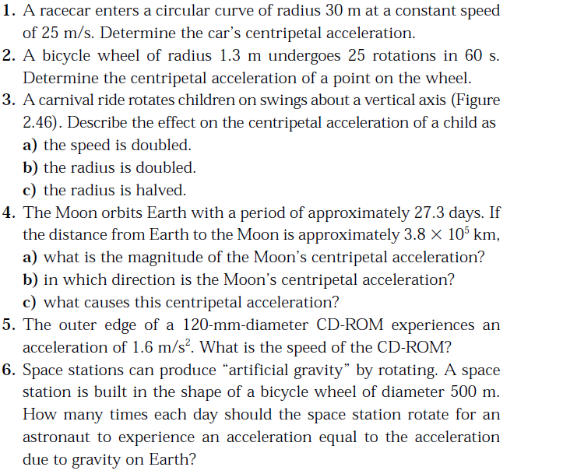
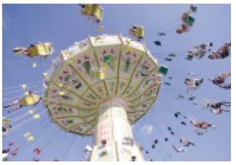
Practice work:

