Slide 1
Work-Energy Theorem
Work : Wnet = Fnetd
However, we know Fnet = ma
So work gives an object some acceleration
Acceleration means the velocity changes

Slide 2
Derivation of Work-Energy Th.
F = m ∆ a
Fd = ma ∆ d
v_{f}² = v_{i}² + 2a∆d → solve for a∆d
a∆d = ½ (v_{f}² – v_{i}²)
F ∆ d = m ½ (v_{f}² – v_{i}²)
Wnet = ½ mv_{f}² – ½ mv_{i}²

Slide 3
Kinetic Energy
Energy due to motion
If something in motion hits an object, the object will move a some distance
KE = ½ mv²
Scalar
Unit is joule (J)

Slide 4
Work-Energy Theorem
Net work done = change in kinetic energy

Slide 5
Example 1
A 0.075-kg arrow is fired horizontally. The bowstring exerts an average force of 65 N on the arrow over a distance of 0.90 m. With what speed does the arrow leave the bow?
39.5 m/s
Notes:
m=0.075 kg
F=65 N
s = 0.90 m
v₀ = 0 m/s
v_{f} = ?
W = KE_{f} – KE_{i}
(65 N)(0.90 m) = ½ (0.075 kg)v_{f}² – ½ (0.075 kg)(0 m/s)²
58.50 J = (0.0375 kg) v_{f}² – 0
1560 (m/s)² = v_{f}²
39.5 m/s = v_{f}

Slide 6
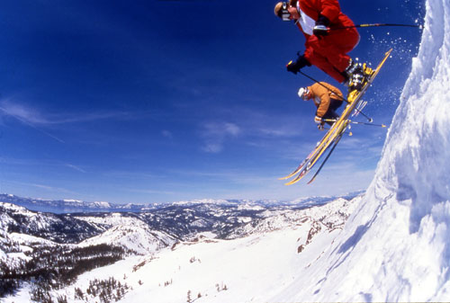
Example 2
A foolish skier, starting from rest, coasts down a mountain that makes an angle of 30° with the horizontal. The coefficient of kinetic friction between her skis and the snow is 0.100. She coasts for a distance of 20 m before coming to the edge of a cliff and lands downhill at a point whose vertical distance is 5 m below the edge. How fast is she going just before she lands?
10.52 m/s
Notes:
Coasting Section
Rotate Axis positive x down hill
F_{y}: -W sin 60 = -.8660mg; F_{N} = .8660 mg
F_{x}: W cos 60 = mg cos 60 = .5mg; -f_{k} = -μF_{N} = -.100(.8660 mg) = -.0866 mg
Sum of F_{x} → .5 mg - .0866 mg = .4134 mg
W = Fs → W = .4134 mg (20 m) = 8.268m mg = (81.03 m²/s²) m
W = KE_{f} – KE_{i} →(81.03 m²/s²) m = ½ m v_{f}² – ½ m 0²
81.03 m²/s² = ½ v_{f}²
162.05 m²/s² = v_{f}²
v_{f} = 12.73 m/s
Free Fall:
v₀ = 12.73 m/s
F_{y} = -W
F_{x} = 0
s_{y} = -5 m W_{y} = -mg (-5 m) = (49 m²/s²) m
W = KE_{f} – KE_{i} → (49 m²/s²) m = ½ (m) v_{f}² – ½ (m) (12.73 m/s)²
49 m²/s² = ½ v_{f}² – 6.365 m²/s²
55.365 m²/s² = ½ v_{f}²
110.73 m²/s² = v_{f}²
10.52 m/s = v_{f}

